Slide 1
Output Report Theory
Business Information Systems – 420-E01
Reference: Technical Communication, A Practical Approach, 7th Ed
Notes:
Pfeiffer book, Chapter 3-5

Slide 2
Outputs
Present information to the users
Most visible component of a working system
We are going to look at the types of output reports, and guidelines for formatting them.
Notes:
Line between what happens at analysis and design is getting more and more blurred

Slide 3
Classify Outputs
Distribution and Audience
Internal Reports
For system owners and users within organization
External Reports
For customers, suppliers, partners, and regulatory agencies
Turnaround Reports
external outputs that eventually re-enter system as inputs

Slide 4
Internal Outputs
Detailed reports
Information with little or no filtering.
Provide managers with information useful in overseeing day-to-day operations of a department or working group.
Summary reports
Categorize information for people who do not want to go through details
Reports show totals, averages, maximums, minimums or other statistical data aggregated over time, personnel, products.
Usually presented in graphical formats using charts
Exception reports
Filter detailed information before presenting it
Show only data that falls outside an accepted/expected range
Notes:
Detailed report
- report of all students
Summary Report
- # of students in each program in the college
Exception report
- report of students in academic difficulty

Slide 5
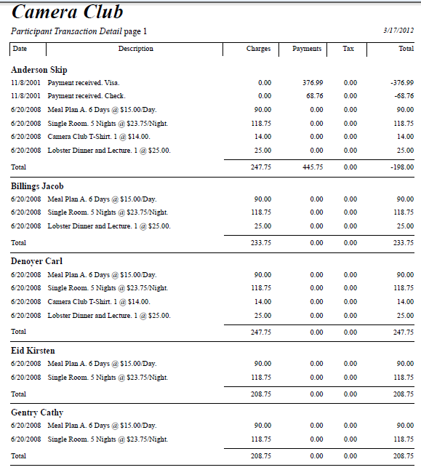
Detailed Report Example

Slide 6
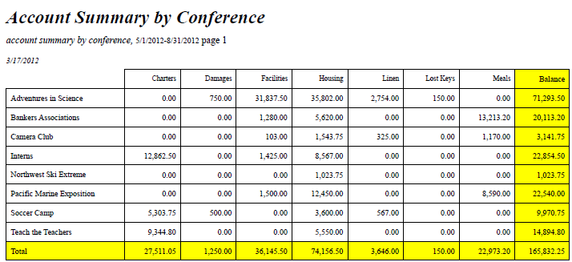
Summary Report Example

Slide 7
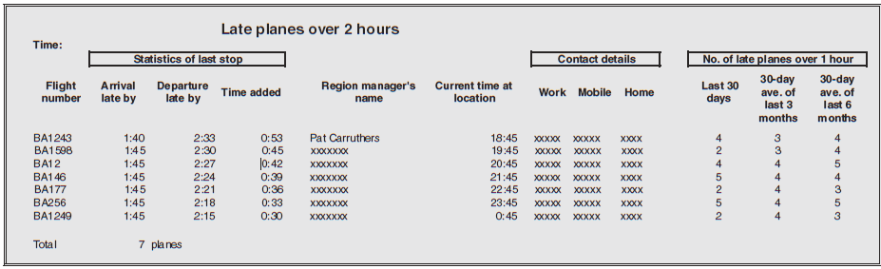
Exception Report Example

Slide 8
Report Filters
Function same as exception reports
Data is filtered before it is presented to the manager as information, but there is no exceptional or unusual situation involved.
Notes:
Example: All students enrolled in CS in 2010 fall semester

Slide 9
Report Formats
Tabular Report
Group Report
Grid Report
Graph Report
Freeform Report
Crosstab Report
Composite Report

Slide 10
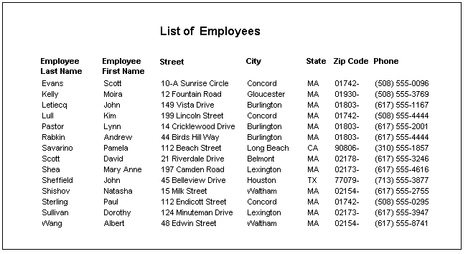
Tabular Report
Headings across top and information displayed in columns under headings

Slide 11
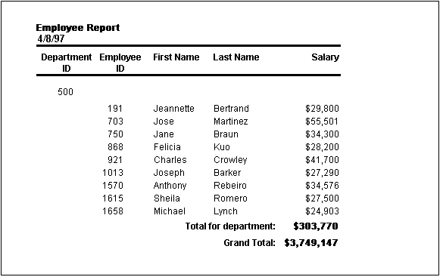
Group Report
Information is grouped according to specified columns and may include subtotals and totals

Slide 12
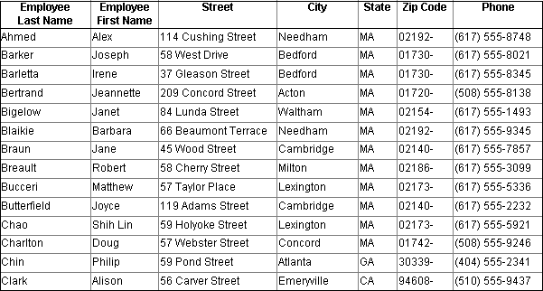
Grid Report
Similar to tabular report, but grid is rigid structure of rows and columns
Looks and acts like a standard spreadsheet.

Slide 13
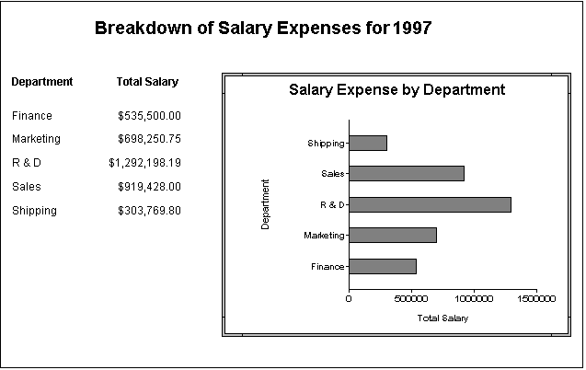
Graph Report
Information is conveyed through the use of a graph or chart

Slide 14
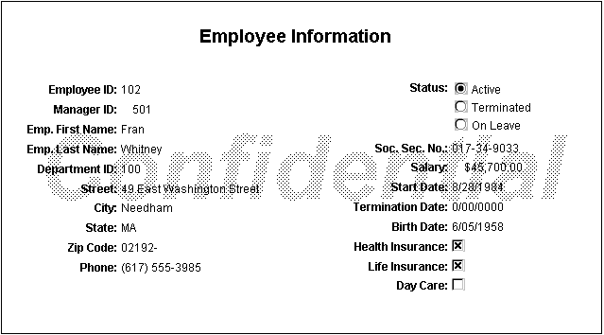
Freeform Report
Information presented one record (or row) at a time

Slide 15
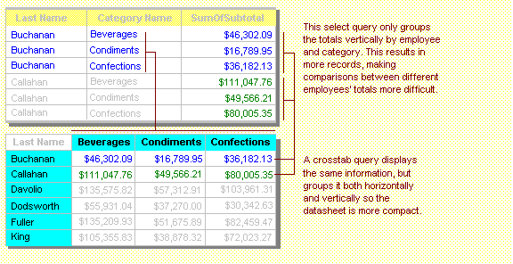
Cross-Tab Report
Information is displayed as summarized values (sum, count, average) from one field and groups them by one set of facts listed down the left side and another set of facts listed across the top
Notes:
Commonly used for trends – columns would be years or months

Slide 16
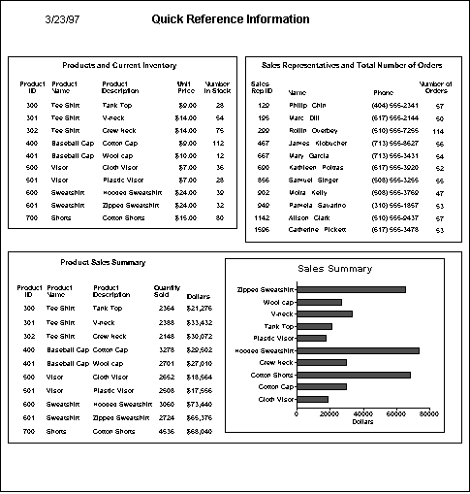
Composite Report
Many report formats on same page

Slide 17
Control-Break Report
A control-break report is simply a report that groups detail lines together and provides sub-headings and/or sub-totals for each group.
The grouping is controlled by one of the data fields, called the control field.
Each set of records with the same control field value is called a control group.
A control break occurs whenever a change occurs in the value of the control field.

Slide 18
Control-Break Example
Apr 04, 2013 Page 1
Heritage Movies and Games
Inventory Report
Media Product Customer Return
Type Number Title Category Format Number Date
----- ------- -------------------- -------- ------ ------- ------
Game 1005 Mercenaries Action DVD 1000 8-Apr-2010
1006 Halo 2 Role-Playing CD
1007 CSI Action DVD 1001 18-Mar-2010
1008 CSI Action CD
4001 Doom III Action CD 1002 5-Apr-2010
Number of Games: 5
Movie 1000 Troy Action DVD
1001 Troy Action BLU-RAY
1002 Catwoman Action DVD
1003 The Forgotten Thriller DVD 1024 8-Apr-2010
1004 Titanic Romance BLU-RAY
1009 Annie Hall Comedy BLU-RAY
4000 Shark Tale Comedy DVD
5000 Raging Bull Drama DVD
5001 The Incredibles Comedy DVD
5002 Adam's Rib Comedy BLU-RAY 1034 8-Apr-2010
Number of Movies: 10
Total number of products: 15
The control field is the media type.
Every time the media type changes, the total of the previous media type is printed and the heading for the current media type is printed.

Slide 19
Report Design Guidelines
Outputs should be easy to read and interpret
Every output should be time and date stamped.
Reports should include headings.
Fields and columns should be clearly labeled.
Reports should include legends for all abbreviations.
Information should never have to be manually edited.
Information should be balanced across the page or screen.
Avoid computer jargon and most error messages.

Slide 20
Formatting Forms and Reports
Meaningful titles: clear, specific, version information, current date
Meaningful information: include only necessary information, with no need to modify
Balanced layout: adequate spacing, margins, and clear labels
Easy navigation system: show how to move forward and backward, and where you are currently

Slide 21
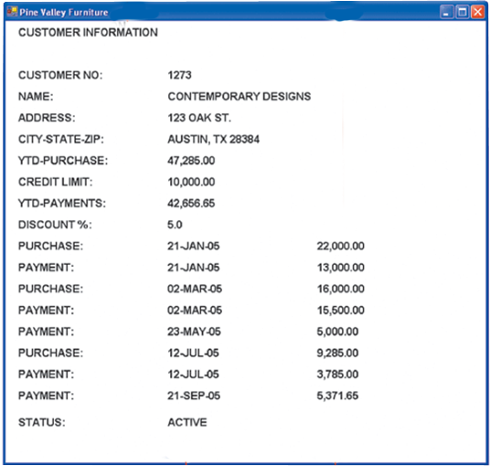
Notes:
Vague title
Difficult to read – information is packed too tightly
No navigation information
No summary information on account activity

Slide 22
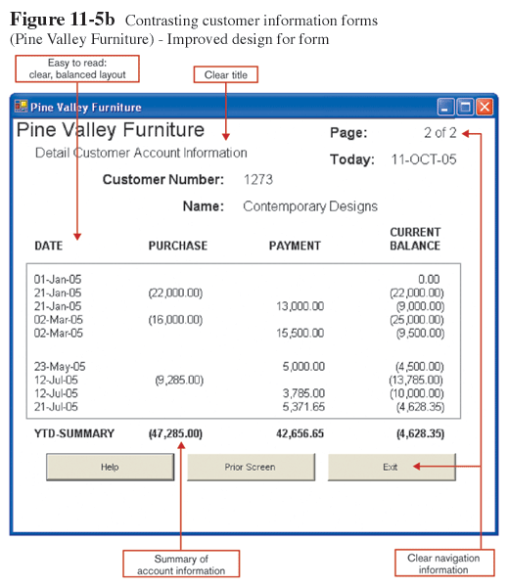
Notes:
Easy to read
Clear title
Summary information
Navigation (must be an online presentation)

Slide 23
Highlighting Information
Notify users of errors in data entry or processing
Provide warnings regarding possible problems
Draw attention to keywords, commands, high-priority messages, unusual data values
Use upper case, change in font size, bold, italics, underline, boxing, and all capital letters
Notes:
Need to provide highlighting of information for the users for various reasons

Slide 24
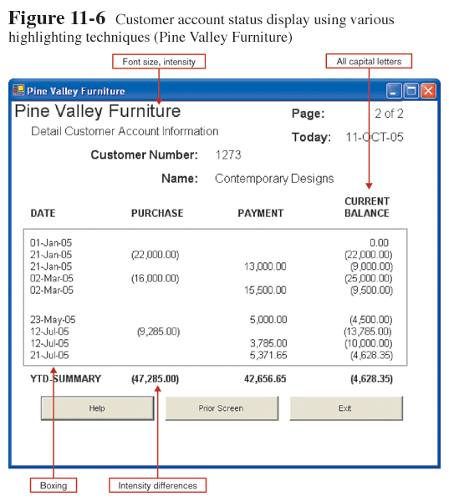

Slide 25
Colour vs. No Colour
Benefits from Using Color
Soothes or strikes the eye
Accents an uninteresting display
Facilitates subtle discriminations in complex displays
Emphasizes the logical organization of information
Draws attention to warnings
Evokes more emotional reactions

Slide 26
Colour vs. No Colour (Cont.)
Problems from Using Colour
Colour pairings may wash out or cause problems for some users
Resolution may degrade with different displays
Color fidelity may degrade on different displays
Printing or conversion to other media may not easily translate

Slide 27
Displaying Text
Case: mixed upper and lower case, use conventional punctuation
Spacing: double spacing if possible, otherwise blank lines between paragraphs
Justification: left justify text, ragged right margins
Hyphenation: no hyphenated words between lines
Abbreviations: only when widely understood and significantly shorter than full text

Slide 28
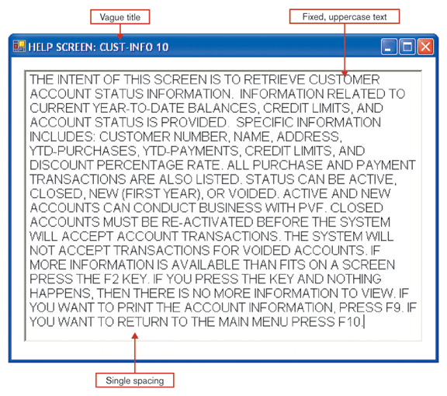

Slide 29
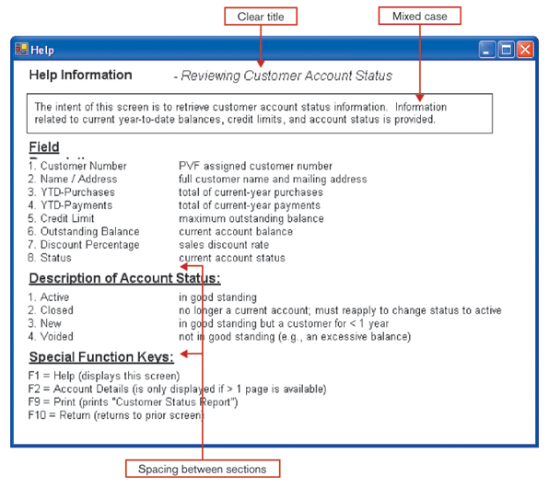

Slide 30
Tables and Lists - Labels
All columns and rows should have meaningful labels
Should be separated from other information by using highlighting
Redisplay when the data extend beyond a single screen or page

Slide 31
Tables and Lists – Columns and Rows
Sort in a meaningful order
Place a blank line between every five rows or so in long columns
Use banding to make row separation more obvious
Similar information displayed in multiple columns should be sorted vertically

Slide 32
Tables and Lists – Columns and Rows
Columns should have at least two spaces between them
Allow white space on printed reports for user to write notes
Use a single typeface, except for emphasis
Use same family of typefaces within and across displays and reports
Avoid overly fancy fonts

Slide 33
Tables and Lists – Formatting Data
Right justify numeric data and align columns by decimal points or other delimiter
Left justify textual data. Use short line length, usually 30 to 40 characters per line
Break long sequences of alphanumeric data into small groups of three to four characters each
Notes:
Numbers can also be decimal-aligned if different number of decimal points

Slide 34
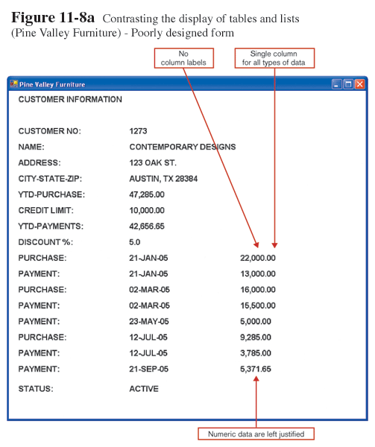
Notes:
No labels on columns
Single Column for all types of data
Numeric data left justified

Slide 35
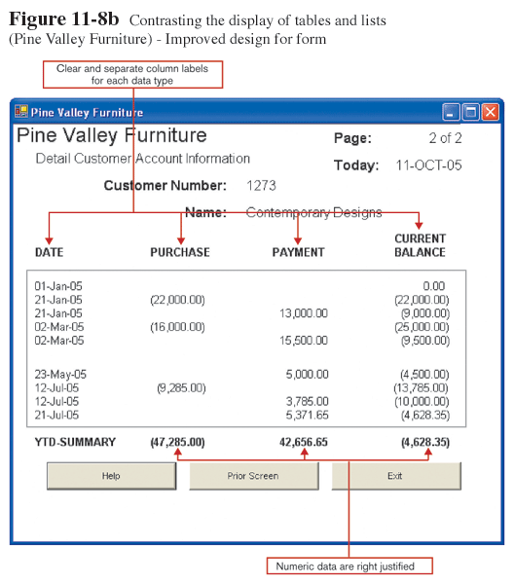

Slide 36
Tables, Lists & Graphs
Use tables for reading individual data values
Use graphs for:
Providing quick summary
Displaying trends over time
Comparing points and patterns of variables
Forecasting activity
Simple reporting of vast quantities of information

Slide 37
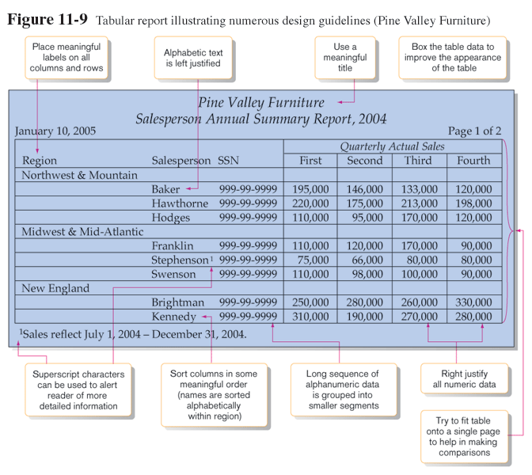

Slide 38
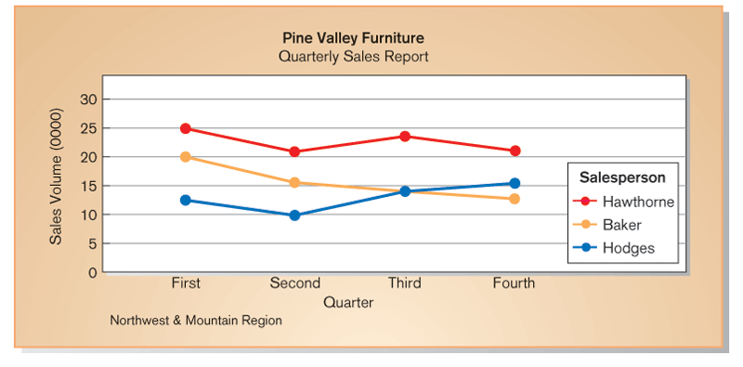
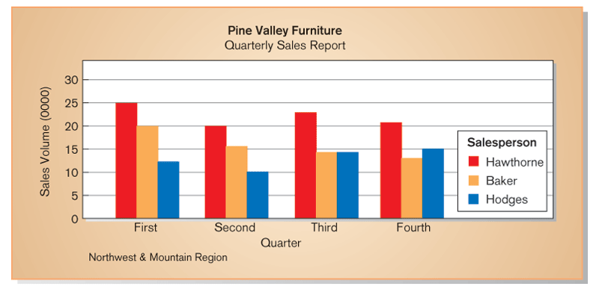

Slide 39
Summary: Report Design Guidelines
Always include a report title, a page number and the date
Use short meaningful column headings (no abbreviations)
Place the columns in a logical order with the identity column (the column that identifies the row – e.g. student number) at the beginning.
Format the column data appropriately.

Slide 40
Summary: Report Design Guidelines
Balance the columns across the screen.
Align the column headings according to the following conventions:
Right-justify over a column of numbers
Left-justify over a column of string data
Provide three spaces between each column

